Slide 1
Theory/Lab: XMPP Protocol
Not for further circulation

Slide 2
Govt. Official Training : Sensors and Actuators under IOT Theory/Lab: XMPP Protocol
Not for further circulation

Slide 3
Content
Where XMPP stands in protocol world
XMPP network architecture
XMPP base protocol
Communication pattern of XMPP
XMPP Stream and stanza Syntax
Work flow of XMPP
Live demo of XMPP using Openfire server and client spark
review of Openfire configuration customizations

Slide 4
Introduction
XMPP(Extensible messaging and presence protocol) is an application oriented protocol
It is an vender independent protocol for instance messaging, presence and request-response services.
XMPP is an open source technology. Uses XML technology for real time communication.
It helps in instance messaging for longer distance.
It has good updates in change of technologies.
Therefore, good protocol in case of scalability.

Slide 5
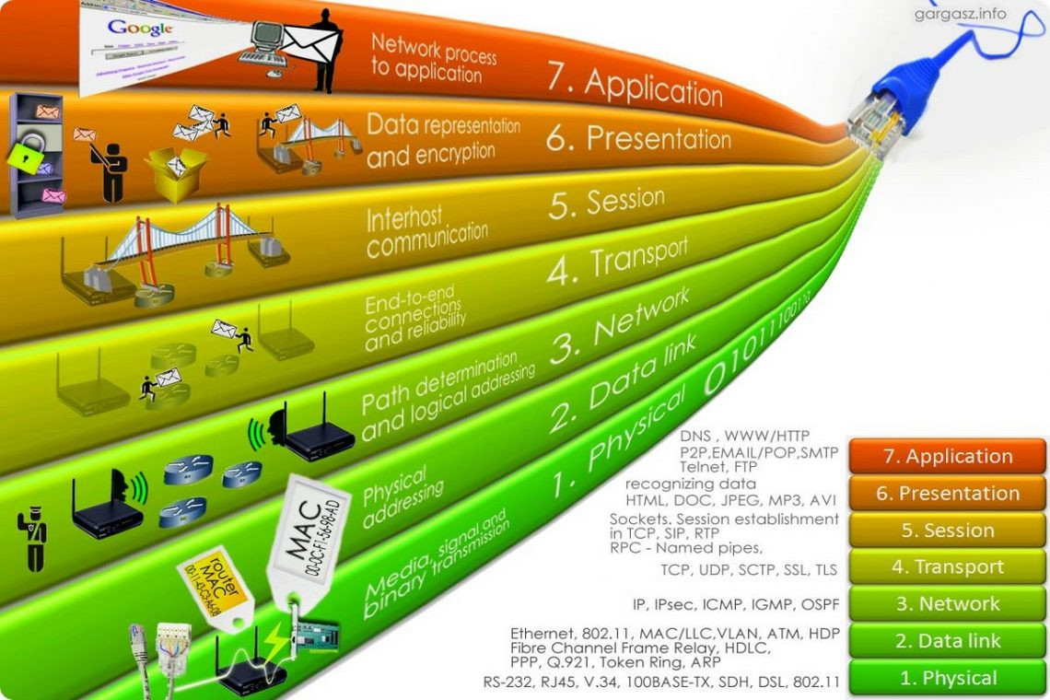
TCP stack
Layering of OSI model:-

Slide 6
The base protocol used is RFC 2779(instance messaging/Presence Protocol Requirements).
There are 2 main concepts with respect to XMPP and they are
XMPP Core.
XMPP Instant messaging.
Presence and Instance Messaging
Presence- presence is a means for finding, retrieving, and subscribing to changes in the presence information(e.g. “online” or “offline”).
Instance messaging- It is a means for sending small, simple messages that are delivered immediately to users.

Slide 7
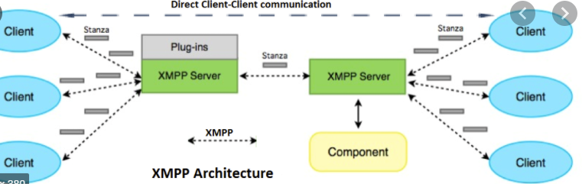
Communication pattern
XMPP uses streaming XML element in order to exchange messages and presence status.
Communication is broken into stanzas.
Stanzas are short contained XML messages which are sent between XMPP client and XMPP server.

Slide 8
Addressing schema
JID-Jabber Identifier:
Format:[node@]domain[/resource]
Domain Identifier:- (Only Required identifier of JID)
Which represents the n/w gateway or primary server to which entities connect.
Node Identifier:- (Optional secondary identifier)
Represents a client or a chat room associated with a multi-user chat service etc.
Resource identifier:- (optional tertiary identifier)
Represents a specific session, connection..

Slide 9
E.g. <room@service/nick>
(where “room” is the name of the chat room and “service” is the hostname of the multi-user chat service and “nick” is the occupant's room nickname)

Slide 10
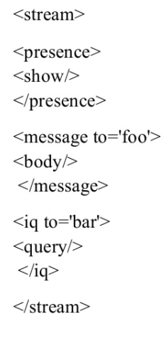
XML Streams and Stanzas
XML Streams:
Container for the exchange of XML elements between any two entities over a network.
The start and end of the XML streams is denoted by <stream> tag and </stream>tag.
XML Stanza:
Is a discrete semantic unit of structure information
E.g. <message
to=‘tom@montague.net’
from=‘jerry@capulet.com/balcony’
xml:lang=‘en’>
<subject>food</subject>
<subject> xml:lang=‘en’</subject>
<body>do u hate me, tom?</body>
<body>xml:lang=‘en’</body>
</message>

Slide 11
Stanzas come in three types.
Presence
IQ(information query stanza)
Message
Presence Stanza:
To express an entity’s current availability status.
Child elements are <show/>, <status/>, <priority>.
<presence>
<show>dnd</show>
</presence>
IQ Stanza:
Is a request-response mechanism
Types of IQ are get(request resource), set(add items on resource), results, error
<iq type=‘get’ id=‘resource_1’>
<query xmls=‘jabber:iq:roster’/>
</iq>

Slide 12
Basic structure of Stanzas is as follows. <[Stanza type][from="][to="][type="][id="]> <child element> <sub-child element> </child element> </Stanza type>
Examples of stanzas:
Messages:
<messages>
from =‘u1@server1.com’
Id=‘M1’
to=‘u2server2.com’
<body>”hello”</body>
</messages>

Slide 13
Presence:-
<Presence>
from =‘u1@server1.com’
Id=‘M1’
to=‘u2server2.com’
<show>”away”</show>
</Presence>
IQ:
<IQ>
from=‘u1@server1.com’
Id=‘M1’
to=‘u2server2.com’
<query>XML=‘jabber:iq:roster’</query>
</IQ>

Slide 14
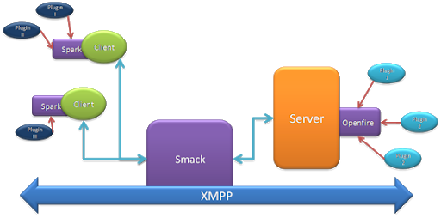
Work Flow Of XMPP Protocol
XMPP protocol is based on typically Client-server architecture, in which XMPP client uses XMPP server via TCP socket.
XMPP uses a federated network(Two business users can talk to each other) of XMPP servers as messaging broker to allow client separated by firewall to communicate with each other.
It uses TLS/SASL for encryption/decryption for Authentication.

Slide 15
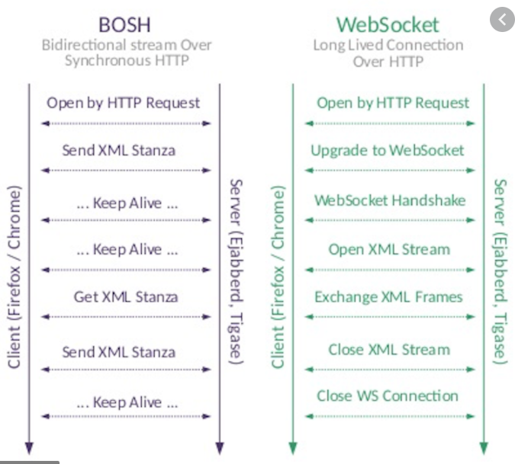
Types of communication in XMPP :
Generally XMPP can communicated via
HTTP over XMPP which is nothing but BOSH technology .
WEBSOCKET for long duration communication.

Slide 16
Based on open source project jabber, there are different provision for different sort of communication by enabling respecting ports such as:
5222:- client-server connection , which is standard port which may or may not be encrypted, security settings can be updated.
5223:- client-server connection for old SSL method, security settings can be updated.
8080:- client-server connection for unsecured Admin console access.
8443:- client-server connection for secured Admin console access.
7777:- File Transfer Proxy in XMPP network.
5229:- Service that allows Flash clients connect to other hostnames and ports.
Notes:
Total ports=>65535
Reserved ports =>1024 to 49151.

Slide 17
Services provided by jabber
File transfer
Voice and Video chat
Desktop screening
Multiuser chat

